Slide 1

Intro to Baseball Scheduling
Steven Witkin
October 2019

Slide 2
The Problem
A league requests a schedule for an upcoming season. Which team will play which? When and where?
What information are we given?
Number of teams in the league and relevant divisional structure
Locations of stadiums and matrix of travel distances
Protected Dates: what dates do certain teams need to be home/away?
Lots of league preferences about series length, travel restrictions, off day placement, start and end dates, interdivisional play, series patterns, etc.
Can we make a schedule which makes people happy (makes the fewest people unhappy)?

Slide 3
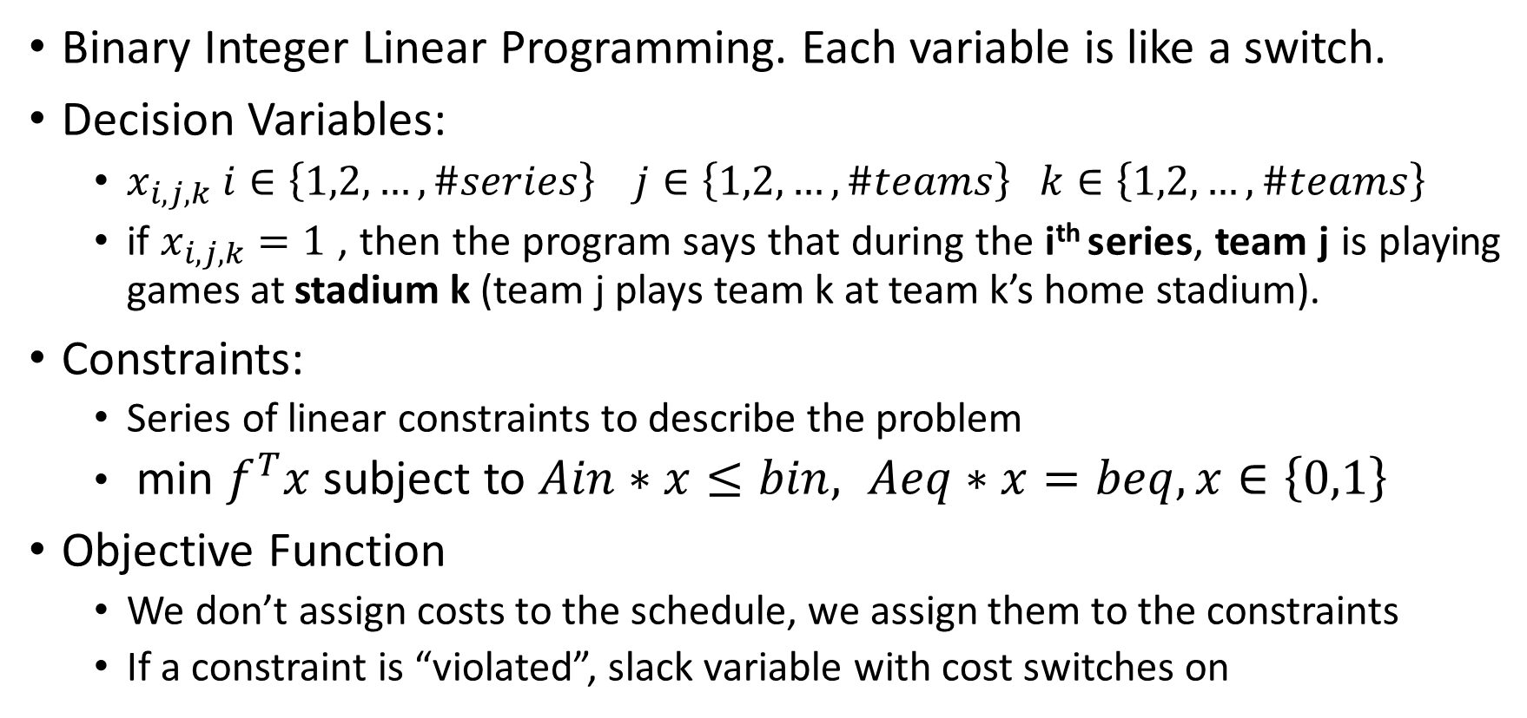
Modeling
Binary Integer Linear Programming. Each variable is like a switch.
Decision Variables:
$x_{i,j,k} i∈\left\{1,2,…,\#series\right\} j∈\left\{1,2,…,\#teams\right\} k∈\left\{1,2,…,\#teams\right\}$
if $x_{i,j,k}=1$ , then the program says that during the i^{th} series, team j is playing games at stadium k (team j plays team k at team k’s home stadium).
Constraints:
Series of linear constraints to describe the problem
min $f^{T}x$ subject to $Ain∗x≤bin, Aeq∗x=beq, x∈\left\{0,1\right\}$
Objective Function
We don’t assign costs to the schedule, we assign them to the constraints
If a constraint is “violated”, slack variable with cost switches on

Slide 4
Example Constraint Groups (depends on league)
Every team plays in every slot (series)
Every slot is home vs visitor
Every team has # home games (what do we need for this to work?)
Every team has # total Friday and Saturday home games
Inter- and intra- divisional structure
Each team is home for one of July 3/4
Discourage one-series roadtrips/homestands
Discourage long travel (usually over 500 miles)
Enforce protected dates and encourage requested dates
No back to back series between teams
No traveling over a rest day
And several more

Slide 5
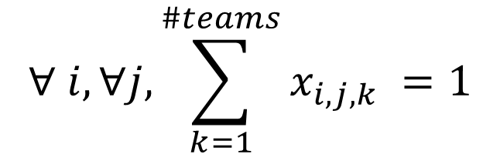
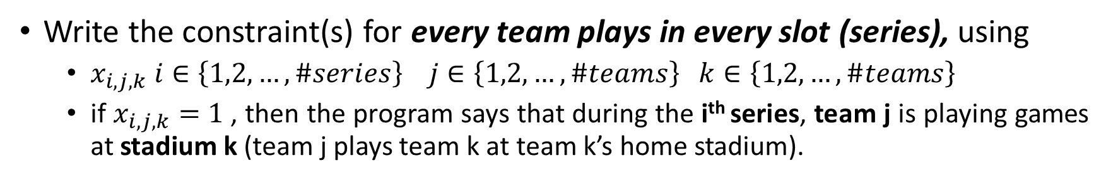
Constraint Writing Practice
Write the constraint(s) for every team plays in every slot (series), using
$x_{i,j,k} i∈\left\{1,2,…,\#series\right\} j∈\left\{1,2,…,\#teams\right\} k∈\left\{1,2,…,\#teams\right\}$
if $x_{i,j,k}=1$ , then the program says that during the i^{th} series, team j is playing games at stadium k (team j plays team k at team k’s home stadium).
“For each series, and for each team, the number of stadiums team j plays at must equal 1”
When combined with the constraint every slot is home vs visitor, this ensures that during each slot, each team will be playing at a single stadium, where there is guaranteed to be another team there to play.
$$∀ i, ∀j, \sum_{k=1}^{\#teams}{x_{i,j,k}} =1$$

Slide 6
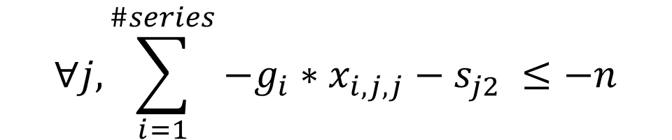
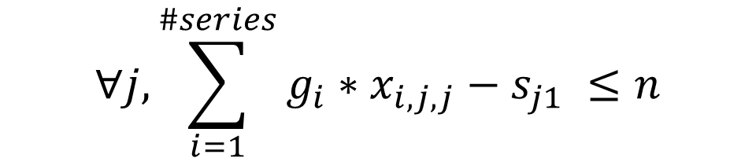
Constraint Writing with Slack Variable
Write the constraint(s) for every team plays n home games, but use slack variables that will equal 1 if a team plays n+1 or n-1 home games. Suppose you have a variable g_{i} which is the number of games in series i.
“For each team, the number of games played in series where team j plays at stadium j (their home stadium) is between n-1 and n+1”
We will put a cost, or “punishment” into the objective function for the slack variables, so the program has incentive to make the number of home games exactly n. We include the slack just in case n games is not feasible.
$$∀j, \sum_{i=1}^{\#series}{g_{i}∗x_{i,j,j}}−s_{j1} ≤n$$
$$∀j, \sum_{i=1}^{\#series}{{−g}_{i}∗x_{i,j,j}}−s_{j2} ≤−n$$

Slide 7
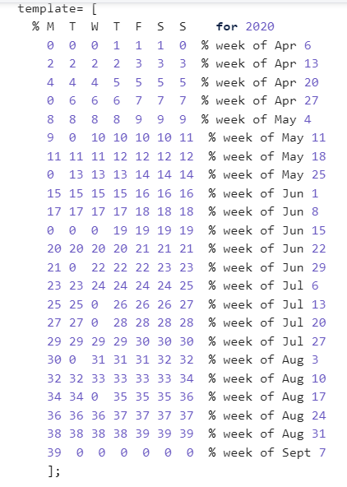
Template
We need to split the season up into series, so we make a template
Some templates are better than others
They can be tailored to work well with protected dates, certain requests, certain constraints such as off day constraints

Slide 8
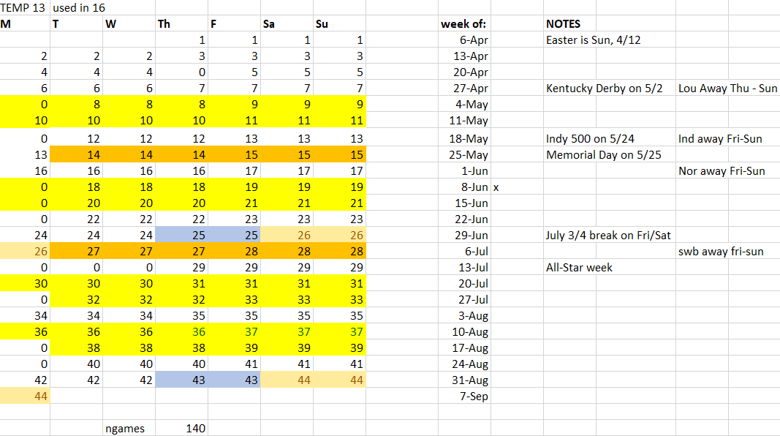
More Complicated Template Example
For example, International league 2020. Their priorities are:
Off days on Monday
Interdivisional not start
until may
No split weekends (F-Sun)
Split July 3rd and 4th
Use 3 and 4 game series
April 9th-Sept 7th 2020
140 games, 9 off days
3 day all star break

Slide 9
General Format of the Code (in MATLAB)
Whichconstraints matrix. Can set punishment values and turn constraints off
Description of Constraints
Template
Code to set up some variables from template (complexity varies)
Protected and requested dates input
More boilerplate code to deal with those
Travel distance information
Sister city pairs (if using)
More boilerplate code to set up the matrices
All of the constraints (the important part!)
Boilerplate code to prepare the matrices, run the program, interpret the solution and output a schedule

Slide 10
Run The Code and Repeat!
After running the code on Ziggy or Chillywilly (our computers)
Outputs:
For Excel: format to put into excel
Nprobs: how many times was each constraint violated?
Problist: More detail, where were the constraints violated?
Put the code output into an Excel file, it formats everything
Take a look over the schedule and the statistics, are there any issues that need to be addressed?
How can these issues be fixed? By changing the template, adding/changing/removing constraints, or altering the punishments.
Does something look odd that the league did not take into account?
It is an iterative process. Solve, improve, repeat until it’s good enough.

Slide 11
What makes a good schedule?
A good schedule is defined differently by each league
If we are facing some tradeoffs, we can ask the league what they prefer
Why do they care so much? Money is on the line.
Candystriping: When there is a repeating pattern of one week home, one away. Some desire, some value other constraints over roughness of schedule.
Semirepeaters: When team A plays at stadium B, and after one intervening series, team B plays at stadium A. Again, some hate, some do not care.

